Slide 1
Python Bootcamp
Week 4

Slide 2
Exercise
Write a program to print numbers 2 to 8 inclusive, using either a while or for loop

Slide 3
Functions

Slide 4
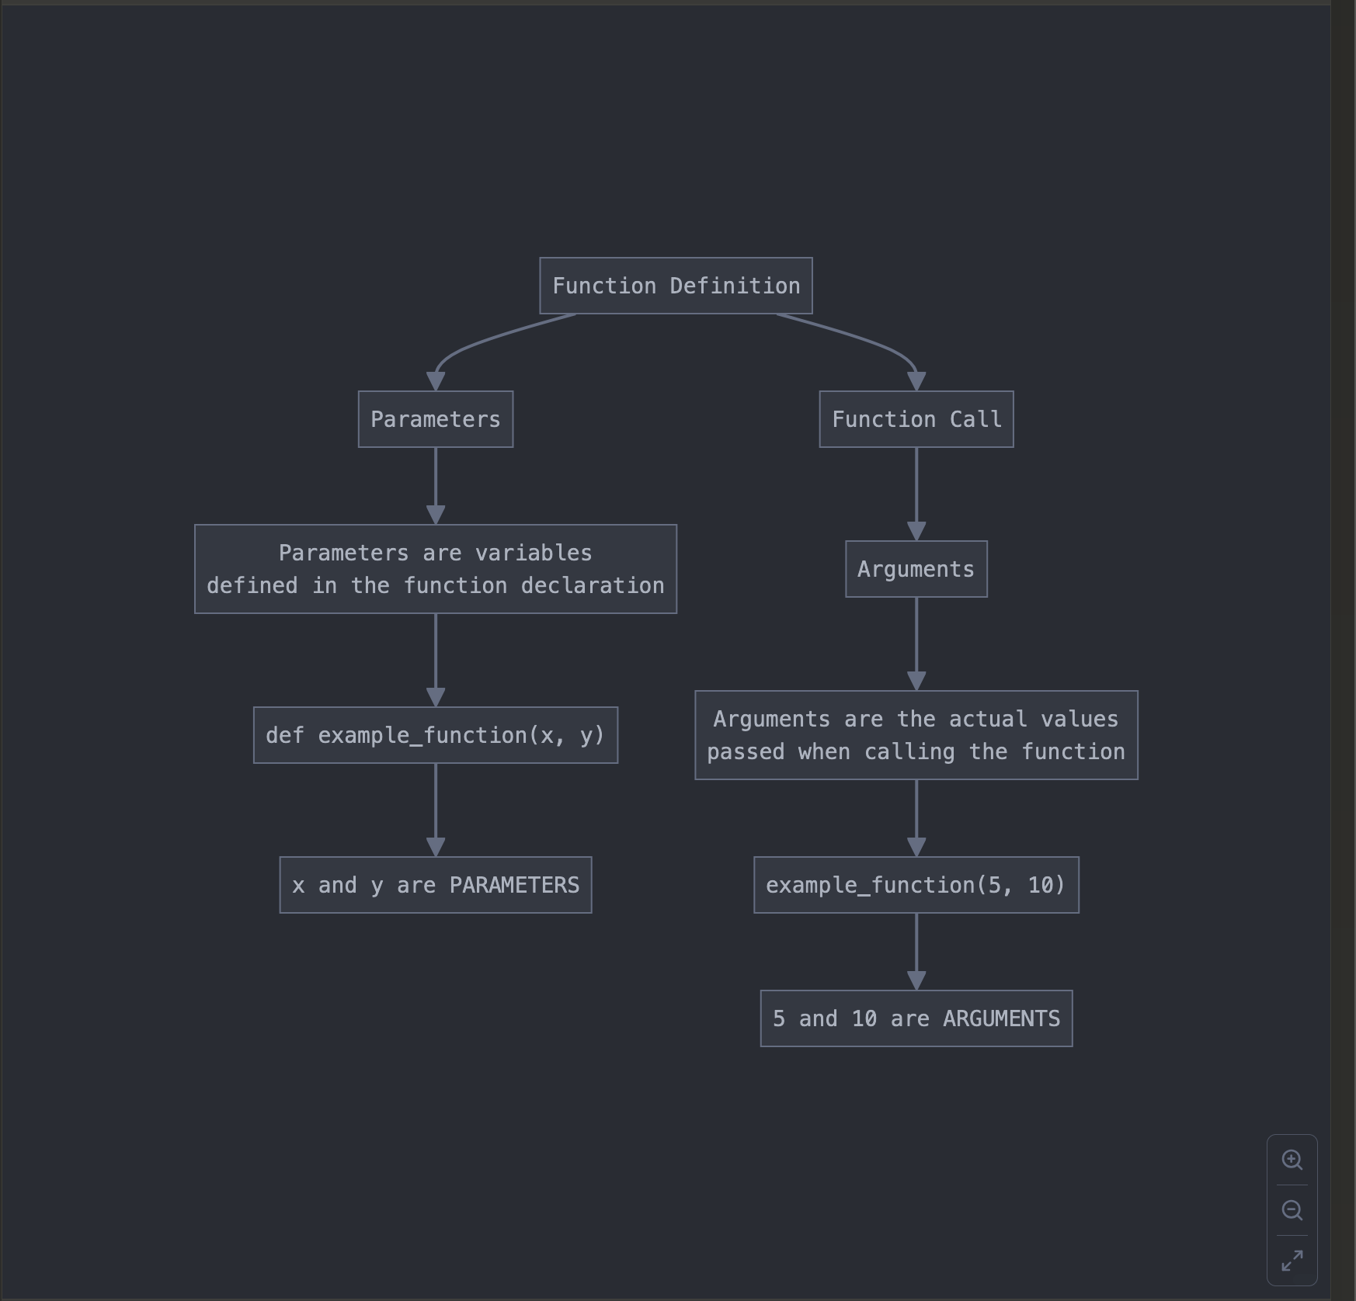

Slide 5
modules

Slide 6
End

